Slide 1
Driving the Transverse Ising Model with an Oscillating Field
Author: Michael Alexander Kurniawan
Supervisor: Professor Xi Dai
Hong Kong University of Science and Technology (HKUST)

Slide 2
01
Introduction
The Transverse Ising Model and Our Motivation

Slide 3
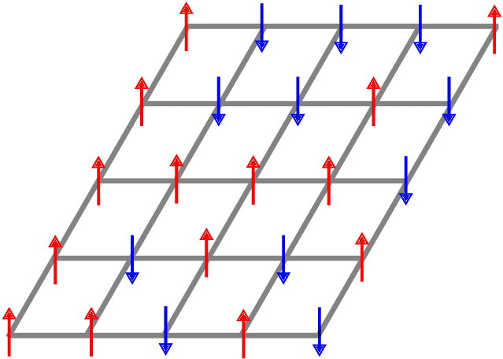
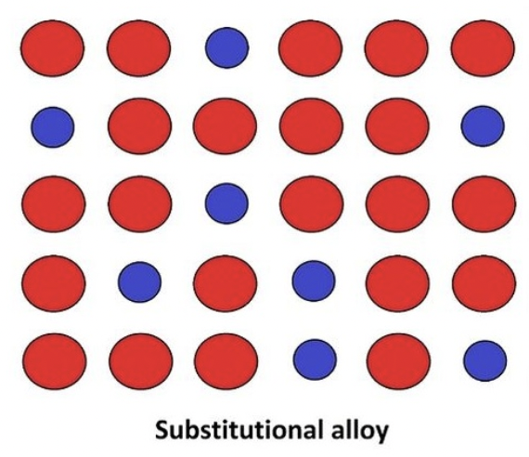
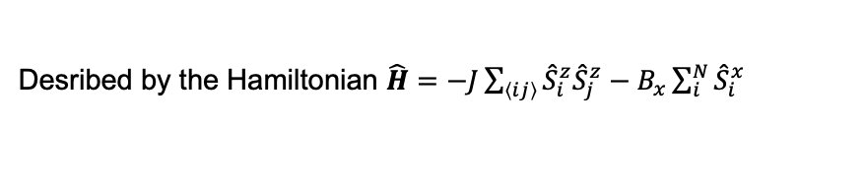
The Ising Model
Firstly, what is the Ising Model?
Desribed by the Hamiltonian $\hat{H}=−J\sum_{\left\langle ij\right\rangle }{{\hat{S}}_{i}^{z}{\hat{S}}_{j}^{z}}−B_{x}\sum_{i}^{N}{{\hat{S}}_{i}^{x}}$
It is a huge lattice of sites, where each site can be in one of two states

Slide 4
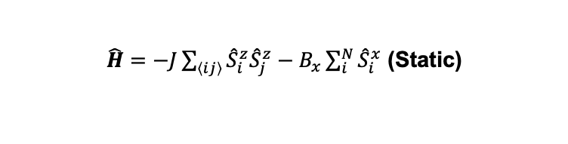
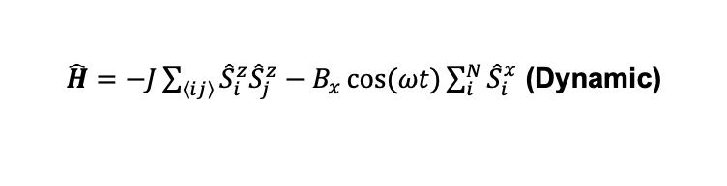
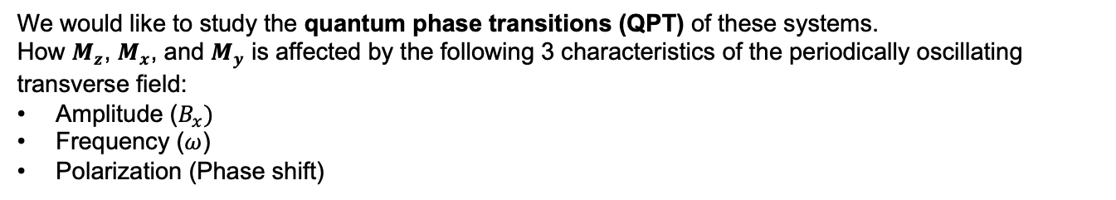
The Transverse Ising Model From static to dynamic!
The Hamiltonian becomes:
$\hat{H}=−J\sum_{\left\langle ij\right\rangle }{{\hat{S}}_{i}^{z}{\hat{S}}_{j}^{z}}−B_{x}\sum_{i}^{N}{{\hat{S}}_{i}^{x}}$ (Static)
$\hat{H}=−J\sum_{\left\langle ij\right\rangle }{{\hat{S}}_{i}^{z}{\hat{S}}_{j}^{z}}−B_{x}\cos{(ωt)}\sum_{i}^{N}{{\hat{S}}_{i}^{x}}$ (Dynamic)
We would like to study the quantum phase transitions (QPT) of these systems.
How $M_{z}$, $M_{x}$, and $M_{y}$ is affected by the following 3 characteristics of the periodically oscillating transverse field:
Amplitude ($B_{x})$
Frequency ($ω$)
Polarization (Phase shift)

Slide 5

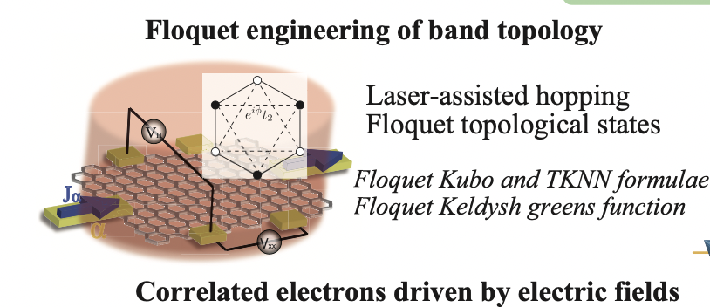
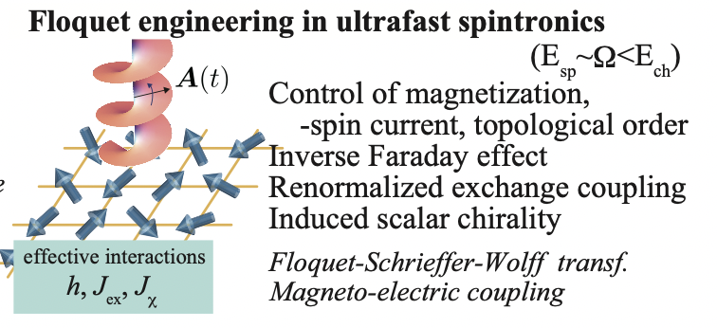
But why do we want to study this at all?
Oka, T., & Kitamura, S. (2019). Floquet engineering of Quantum Materials. Annual Review of Condensed Matter Physics, 10(1), 387–408. https://doi.org/10.1146/annurev-conmatphys-031218-013423
Experimental result shows that we could coherently control the inherent property of quantum materials using lasers or driven electric field
As a theoretical toy model!

Slide 6
And many more applications to come!
Oka, T., & Kitamura, S. (2019). Floquet engineering of Quantum Materials. Annual Review of Condensed Matter Physics, 10(1), 387–408. https://doi.org/10.1146/annurev-conmatphys-031218-013423
Tailored fields from metamaterial plasmonics
Phase transition in a nonequilibrium state
Floquet engineering exotic quantum phases such as a chiral spin liquid phase
Correlated Electrons Driven by Electric Fields
Control and detection of spin chirality using laser
Ultrafast Spintronics
Floquet Engineering

Slide 7
02
Method of Attack
Mean Field Approximation & Floquet Theory

Slide 8
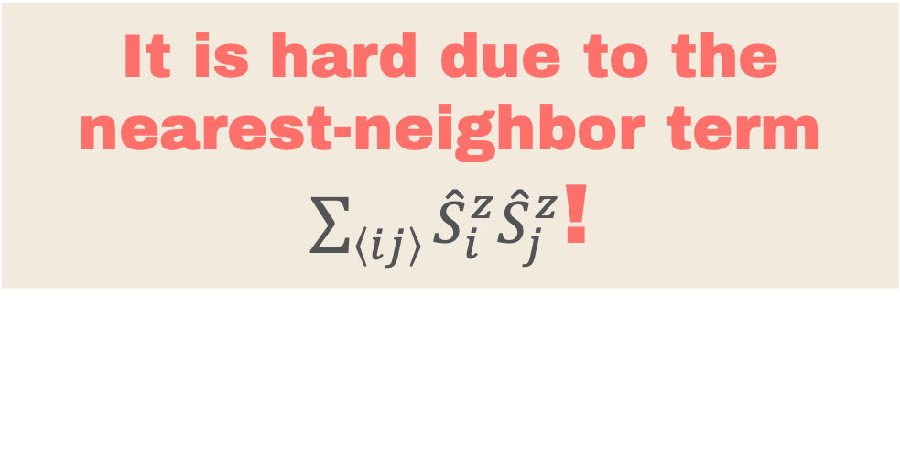
It is hard due to the nearest-neighbor term $\sum_{\left\langle ij\right\rangle }{{\hat{S}}_{i}^{z}{\hat{S}}_{j}^{z}}$!
Hence the Mean Field approximation!

Slide 9
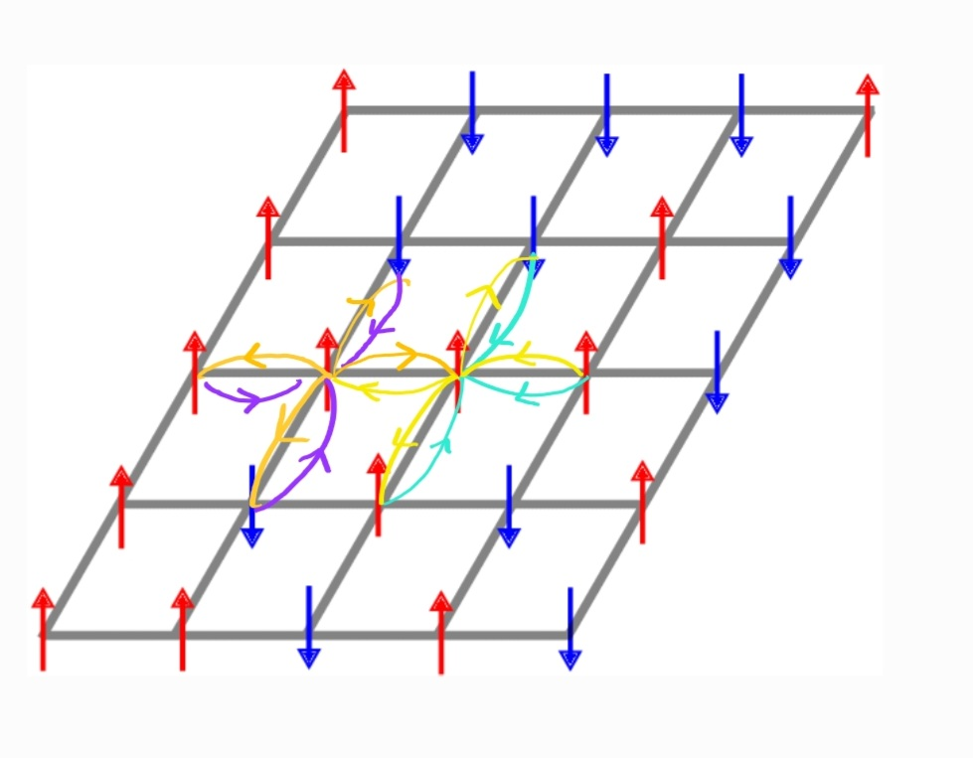
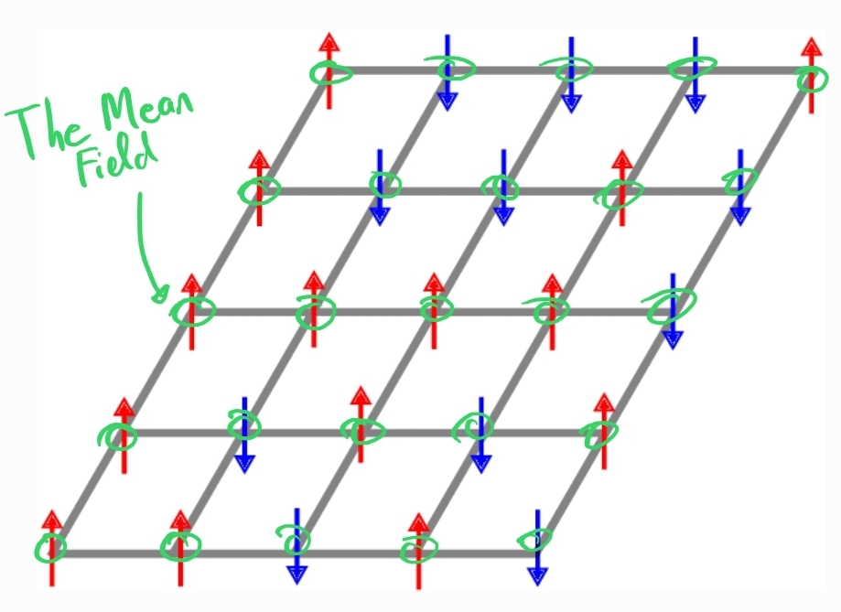
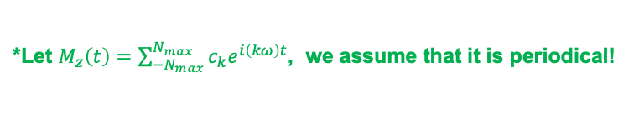

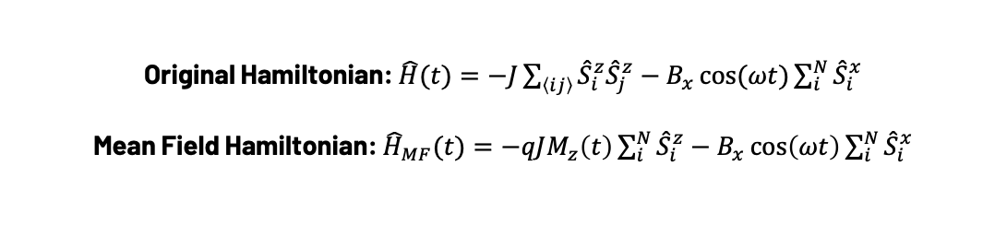
Mean Field Theory (MFT) Approximation
What is the Mean Field Approximation?
We consider the system has temperature $T=0K$ and in the ground state:
MFT
Original Hamiltonian: $\hat{H}(t)=−J\sum_{\left\langle ij\right\rangle }{{\hat{S}}_{i}^{z}{\hat{S}}_{j}^{z}}−B_{x}\cos{(ωt)}\sum_{i}^{N}{{\hat{S}}_{i}^{x}}$
Mean Field Hamiltonian: ${\hat{H}}_{MF}(t)=−qJM_{z}\left(t\right)\sum_{i}^{N}{{\hat{S}}_{i}^{z}}−B_{x}\cos\left(ωt\right)\sum_{i}^{N}{{\hat{S}}_{i}^{x}}$
*Let $M_{z}\left(t\right)=\sum_{−N_{max}}^{N_{max}}{c_{k}e^{i\left(kω\right)t}}$, we assume that it is periodical!
The Mean Field itself, where $q$ is the number of nearest neighbor
Notes:
Static case explain it on the presentation
Monte carlo of course can do it numerically,
Now we want to generalize it to peridocailly driven from static case, dynamical transverse field problem.

Slide 10
How do you solve the periodical Mean-Field Hamiltonian?
Floquet Theory comes to the rescue!

Slide 11
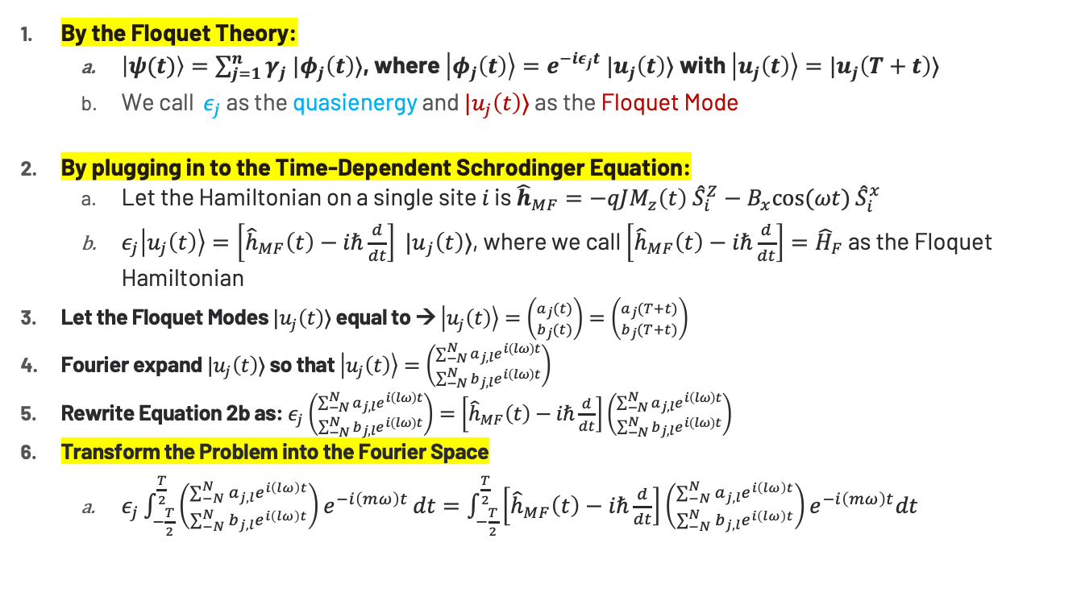
The Floquet Formalism
By the Floquet Theory:
$\left|ψ(t)\right\rangle =\sum_{j=1}^{n}{γ_{j} |φ_{j}\left(t\right)⟩}$, where $\left|φ_{j}\left(t\right)\right\rangle =e^{−iε_{j}t} |u_{j}\left(t\right)⟩$with $\left|u_{j}\left(t\right)\right\rangle =|u_{j}\left(T+t\right)⟩$
We call $ε_{j}$ as the quasienergy and $|u_{j}\left(t\right)⟩$ as the Floquet Mode
By plugging in to the Time-Dependent Schrodinger Equation:
Let the Hamiltonian on a single site $i$ is ${\hat{h}}_{MF}=−qJM_{z}\left(t\right) {\hat{S}}_{i}^{Z}−B_{x}cos⁡(ωt)$ ${\hat{S}}_{i}^{x}$
$ε_{j}\left|u_{j}\left(t\right)\right\rangle =\left[{\hat{h}}_{MF}\left(t\right)−iℏ\frac{d}{dt}\right] {|u}_{j}\left(t\right)⟩$, where we call $\left[{\hat{h}}_{MF}\left(t\right)−iℏ\frac{d}{dt}\right]={\hat{H}}_{F}$ as the Floquet Hamiltonian
Let the Floquet Modes $|u_{j}\left(t\right)⟩$ equal to → $\left|u_{j}\left(t\right)\right\rangle =\left({a_{j}(t) \atop b_{j}(t)}\right)=\left({a_{j}(T+t) \atop b_{j}(T+t)}\right)$
Fourier expand $|u_{j}\left(t\right)⟩$ so that $\left|u_{j}\left(t\right)\right\rangle =\left({\sum_{−N}^{N}{a_{j,l}e^{i\left(lω\right)t}} \atop \sum_{−N}^{N}{b_{j,l}e^{i\left(lω\right)t}}}\right)$
Rewrite Equation 2b as: $ε_{j}\left({\sum_{−N}^{N}{a_{j,l}e^{i\left(lω\right)t}} \atop \sum_{−N}^{N}{b_{j,l}e^{i\left(lω\right)t}}}\right)=\left[{\hat{h}}_{MF}\left(t\right)−iℏ\frac{d}{dt}\right]\left({\sum_{−N}^{N}{a_{j,l}e^{i\left(lω\right)t}} \atop \sum_{−N}^{N}{b_{j,l}e^{i\left(lω\right)t}}}\right)$
Transform the Problem into the Fourier Space
$ε_{j}\int_{−\frac{T}{2}}^{\frac{T}{2}}{\left({\sum_{−N}^{N}{a_{j,l}e^{i\left(lω\right)t}} \atop \sum_{−N}^{N}{b_{j,l}e^{i\left(lω\right)t}}}\right)e^{−i\left(mω\right)t}}dt=\int_{−\frac{T}{2}}^{\frac{T}{2}}{\left[{\hat{h}}_{MF}\left(t\right)−iℏ\frac{d}{dt}\right]\left({\sum_{−N}^{N}{a_{j,l}e^{i\left(lω\right)t}} \atop \sum_{−N}^{N}{b_{j,l}e^{i\left(lω\right)t}}}\right)e^{−i\left(mω\right)t}dt}$
Notes:
JANGAN LUPA NGOMONG FLOQUET THEORY ITU MINDAHIN PROBLEM KITA DARI YANG BIASANYA COEFFICIENTNYA YANG TIME DEPENDENT JADI KE FLOQUET MODESNYA YANG TIME DEPENDENT AND SEKARANG COEFFICIENTNYA CONSTANT WHICH IS THE COEFFICIENT AT TIME t = 0!

Slide 12
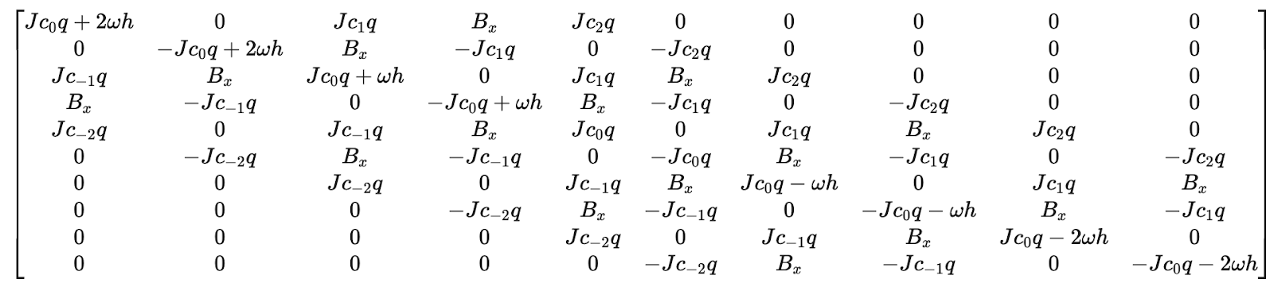
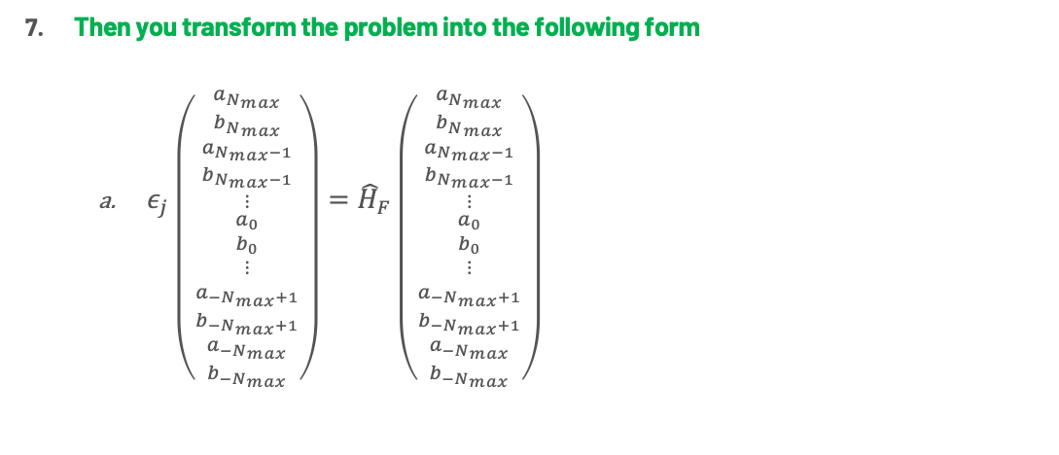
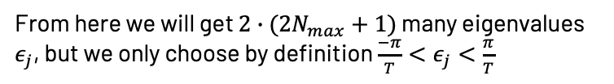

Floquet Theory
Then you transform the problem into the following form
$ε_{j}\left({\begin{matrix}a_{N_{max}} \\ {b_{N}}_{max} \\ a_{N_{max}−1}\end{matrix} \atop \begin{matrix}b_{N_{max}−1} \\ ⋮ \\ \begin{matrix}a_{0} \\ b_{0} \\ \begin{matrix}⋮ \\ a_{{−N}_{max}+1} \\ \begin{matrix}b_{−N_{max}+1} \\ a_{−N_{max}} \\ b_{{−N}_{max}}\end{matrix}\end{matrix}\end{matrix}\end{matrix}}\right)={\hat{H}}_{F}\left({\begin{matrix}a_{N_{max}} \\ {b_{N}}_{max} \\ a_{N_{max}−1}\end{matrix} \atop \begin{matrix}b_{N_{max}−1} \\ ⋮ \\ \begin{matrix}a_{0} \\ b_{0} \\ \begin{matrix}⋮ \\ a_{{−N}_{max}+1} \\ \begin{matrix}b_{−N_{max}+1} \\ a_{−N_{max}} \\ b_{{−N}_{max}}\end{matrix}\end{matrix}\end{matrix}\end{matrix}}\right)$
From here we will get $2∙(2N_{max}+1)$ many eigenvalues $ε_{j}$, but we only choose by definition $\frac{−π}{T}<ε_{j}<\frac{π}{T}$
Example of ${\hat{H}}_{F}$ with $N_{max}=2$→

Slide 13
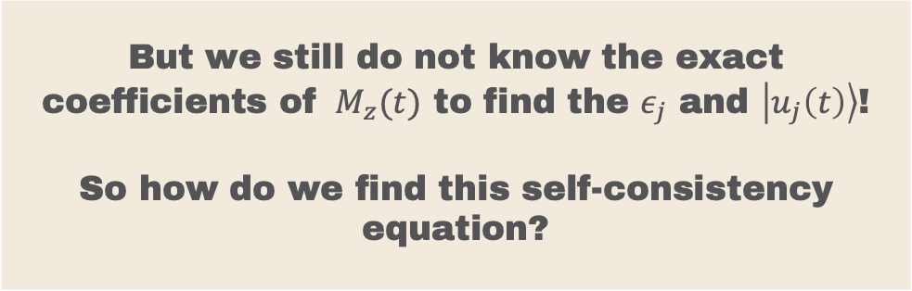
But we still do not know the exact coefficients of $M_{z}(t)$ to find the $ε_{j}$ and $\left|u_{j}\left(t\right)\right\rangle$! So how do we find this self-consistency equation?
We implement numerical iteration method!

Slide 14

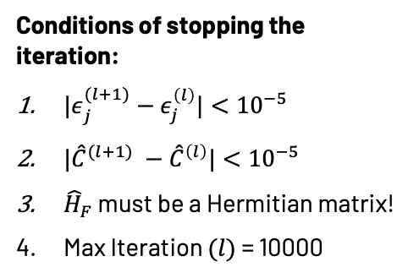
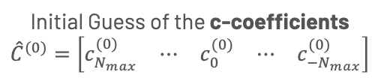
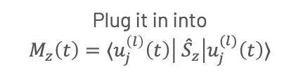
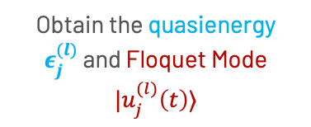
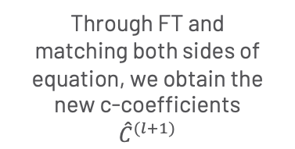
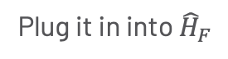
Old Numerical Iteration Algorithm
Initial Guess of the c-coefficients $${\hat{C}}^{(0)}=\left[\begin{matrix}c_{N_{max}}^{(0)} & ⋯ & \begin{matrix}c_{0}^{(0)} & ⋯ & c_{{−N}_{max}}^{(0)}\end{matrix}\end{matrix}\right]$$
Plug it in into ${\hat{H}}_{F}$
Obtain the quasienergy $ε_{j}^{(l)}$ and Floquet Mode $|u_{j}^{(l)}\left(t\right)⟩$
Check for convergence
Finish
Conditions of stopping the iteration:
${|ε}_{j}^{(l+1)}−ε_{j}^{\left(l\right)}|<{10}^{−5}$
${|\hat{C}}^{(l+1)} −{\hat{C}}^{\left(l\right)}|<{10}^{−5}$
${\hat{H}}_{F}$ must be a Hermitian matrix!
Max Iteration $(l)$= 10000
Through FT and matching both sides of equation, we obtain the new c-coefficients ${\hat{C}}^{(l+1)}$
Plug it in into
$$M_{z}\left(t\right)=⟨u_{j}^{\left(l\right)}\left(t\right)\left| {\hat{S}}_{z}\right|u_{j}^{(l)}\left(t\right)⟩$$
Notes:
PAKE NOTASINYA ${\hat{C}}^{l}=[c]$

Slide 15
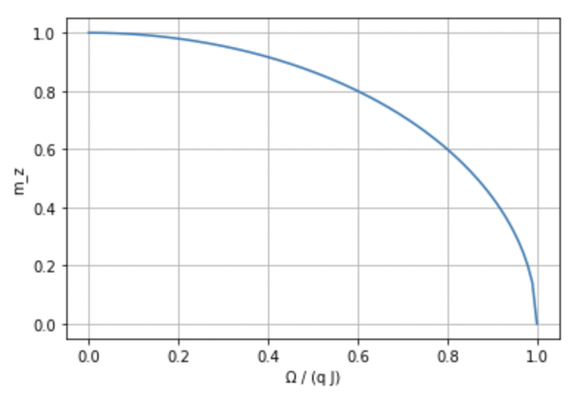
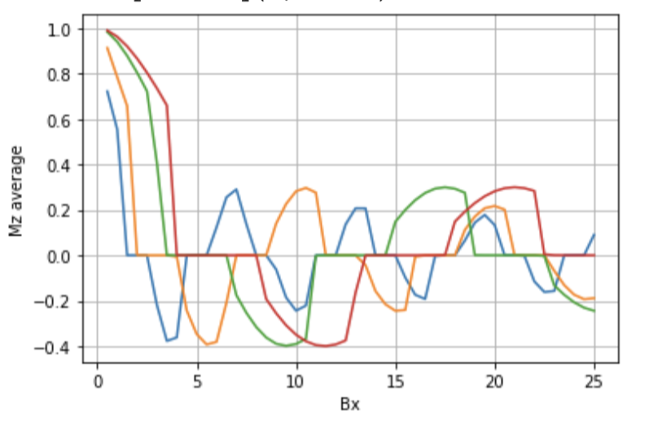
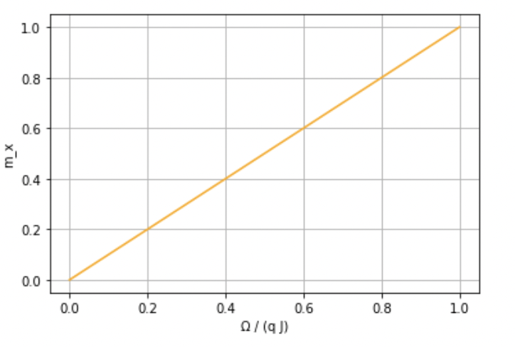
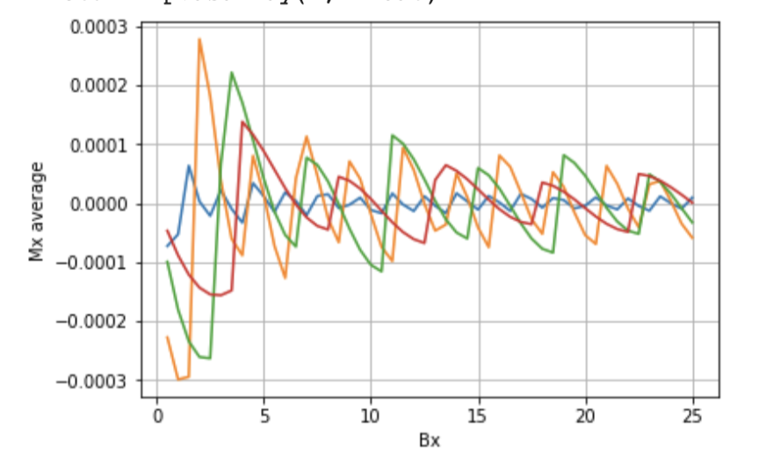

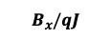


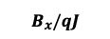



$\overline{M_{z}}$ VS$B_{x}$ (OLD) Comparison with Static Field Case
Oscillating Transverse Field (a close up)
$qJ=2;B_{x}=[0.4, 2]$
Static Transverse Field
$$ω=4$$
$$ω=5$$
$$ω=6$$
$$ω=10$$
$$B_{x}/qJ$$
$$ω=4$$
$$ω=5$$
$$ω=6$$
$$ω=10$$
$$B_{x}/qJ$$

Slide 16
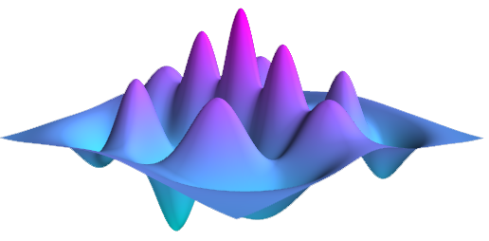
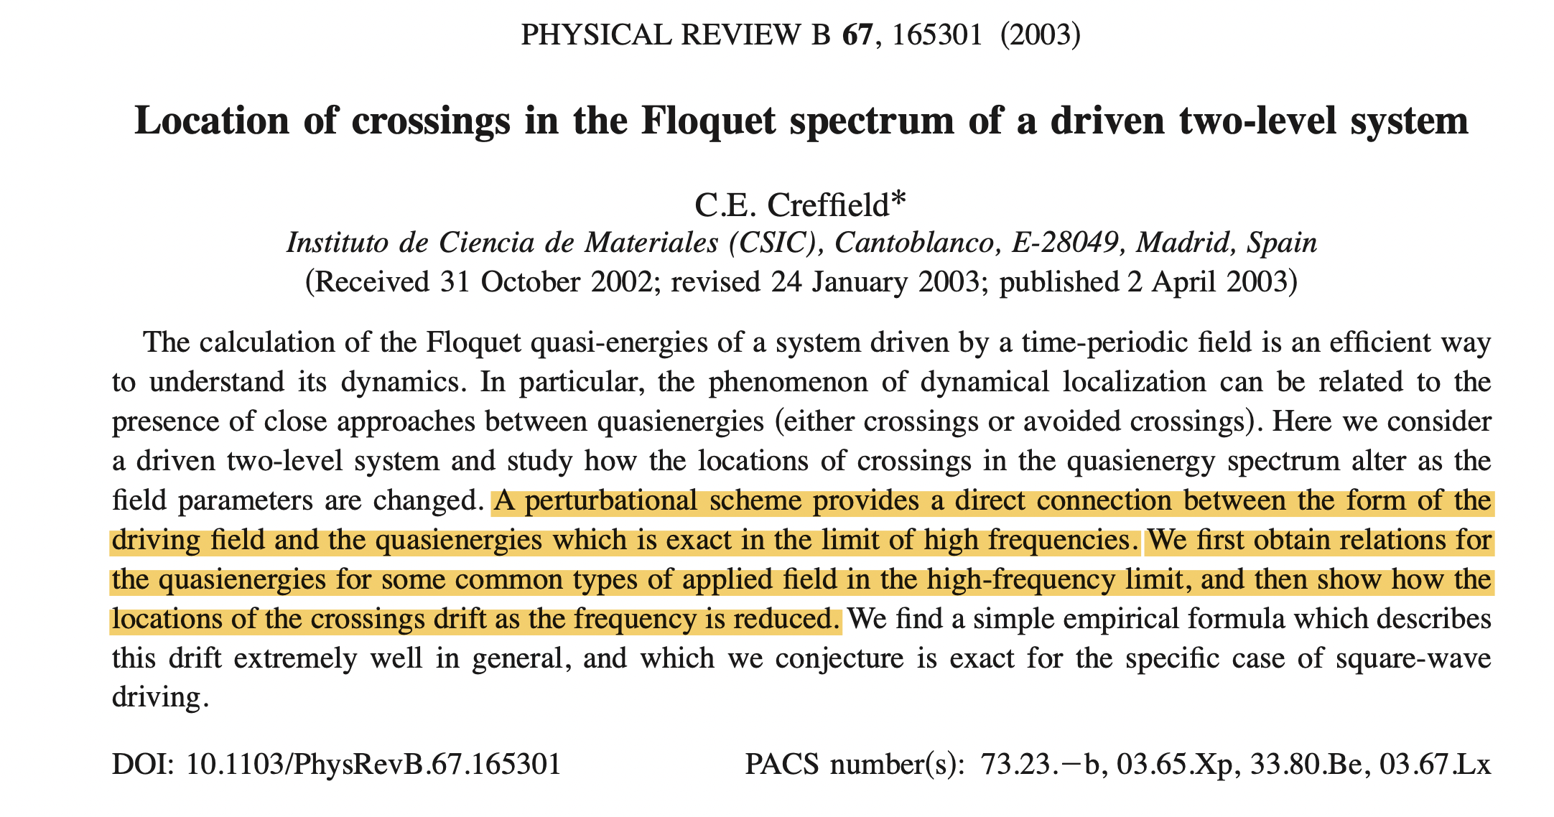
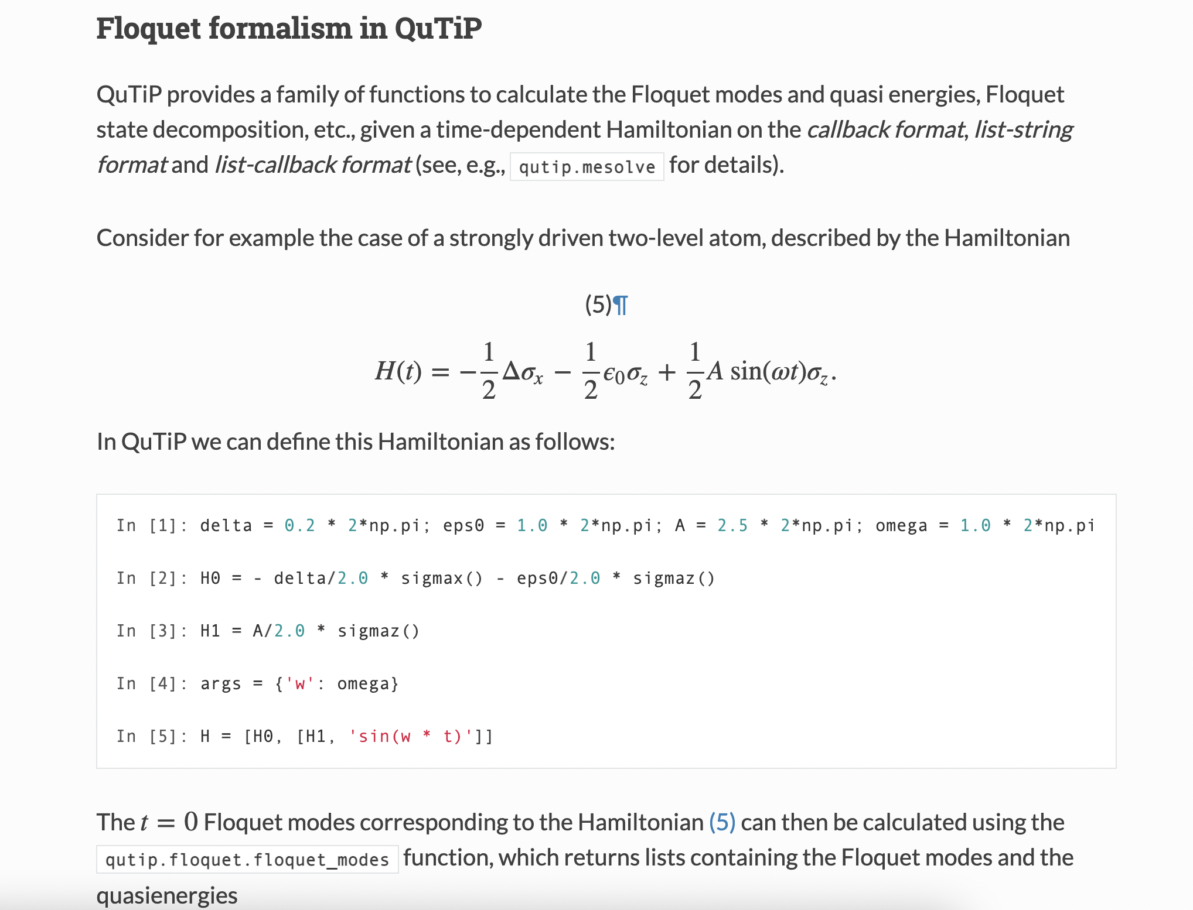
QuTiP Library
The Quantum Toolbox in Python, or QuTiP, is an open-source implementation of a framework written in the Python programming language designed for simulating the open quantum dynamics

Slide 17
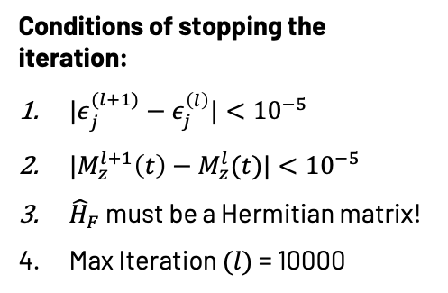
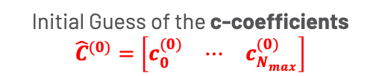
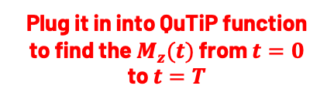
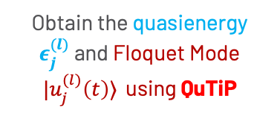
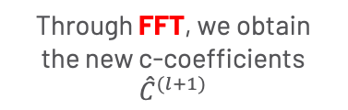
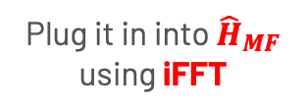
New Numerical Iteration Algorithm
Initial Guess of the c-coefficients $${\hat{C}}^{(0)}=\left[\begin{matrix}c_{0}^{(0)} & ⋯ & c_{N_{max}}^{(0)}\end{matrix}\right]$$
Plug it in into ${\hat{H}}_{MF}$ using iFFT
Obtain the quasienergy $ε_{j}^{(l)}$ and Floquet Mode $|u_{j}^{(l)}\left(t\right)⟩$ using QuTiP
Conditions of stopping the iteration:
${|ε}_{j}^{(l+1)}−ε_{j}^{\left(l\right)}|<{10}^{−5}$
${|M}_{z}^{l+1}\left(t\right)−M_{z}^{l}(t)|<{10}^{−5}$
${\hat{H}}_{F}$ must be a Hermitian matrix!
Max Iteration $(l)$= 10000
Check for convergence
Finish
Through FFT, we obtain the new c-coefficients ${\hat{C}}^{(l+1)}$
Plug it in into QuTiP function to find the $M_{z}(t)$ from $t=0$ to $t=T$
Notes:
PAKE NOTASINYA ${\hat{C}}^{l}=[c]$

Slide 18
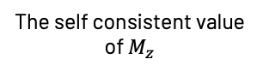
General Method Flow
Transverse Ising Model driven by an oscillating field
Mean Field Approximation
Numerical Iteration (using QuTiP)
Floquet Theory
The self consistent value of $M_{z}$

Slide 19
New Results from QuTiP
And comparison between the previous algorithm

Slide 20
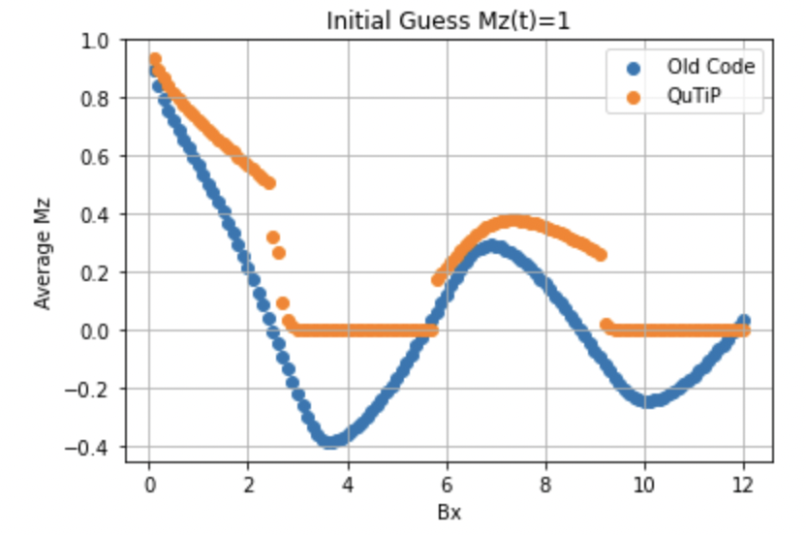
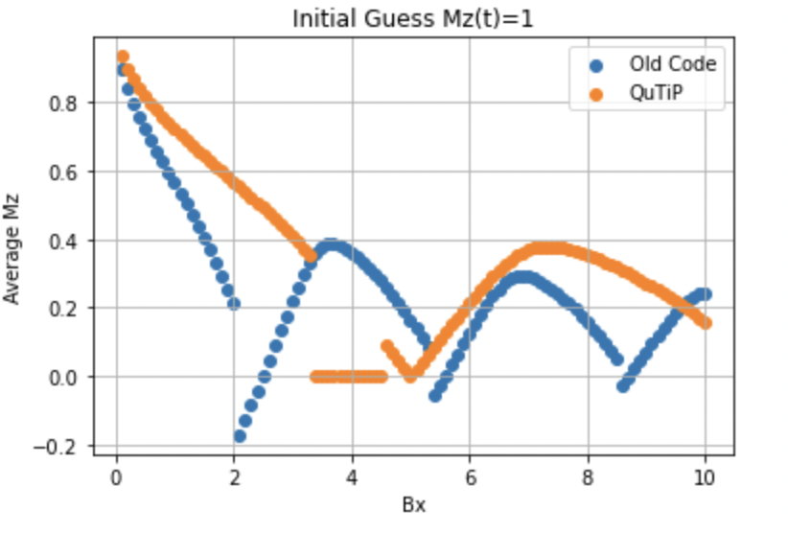
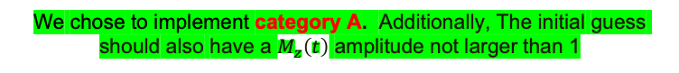
Firstly, regarding initial guesses
Category A: Use the previous $B_{x}$ converging result as an initial guess
Category B: Does not use the previous $B_{x}$ converging result as an initial guess
Category A
Category B
We chose to implement category A. Additionally, The initial guess should also have a $M_{z}\left(t\right)$ amplitude not larger than 1
The QuTiP also gives the domes and plateau characteristics as seen before from the old code!

Slide 21
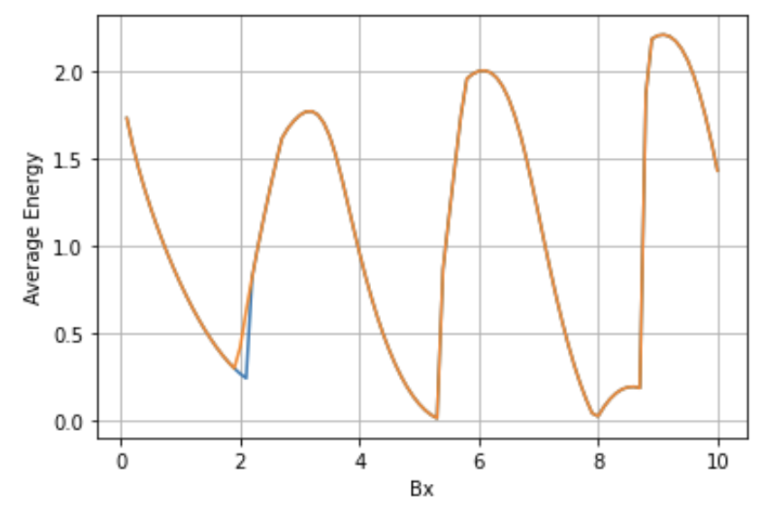
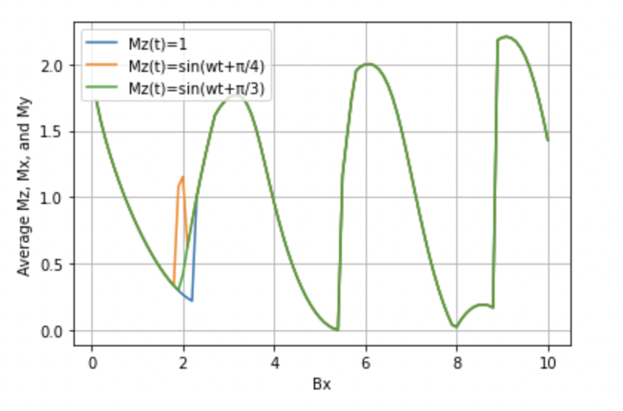
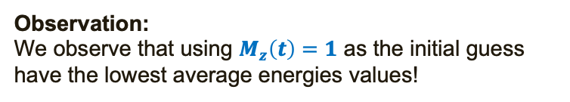
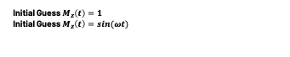
Firstly, regarding initial guesses
Looking from the energies of different initial guesses, we see that a good choice of initial guess is $M_{z}\left(t\right)=1$ when we use category A
Initial Guess $M_{z}\left(t\right)=1$
Initial Guess $M_{z}\left(t\right)=\sin{(ωt)}$
Average Energy
Observation:
We observe that using $M_{z}\left(t\right)=1$ as the initial guess have the lowest average energies values!

Slide 22
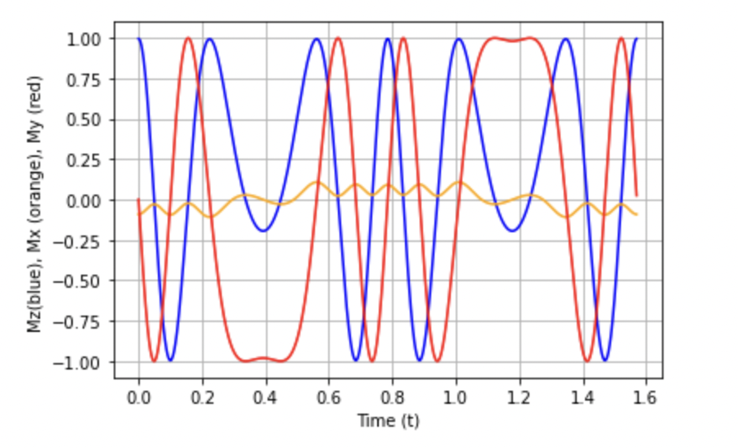
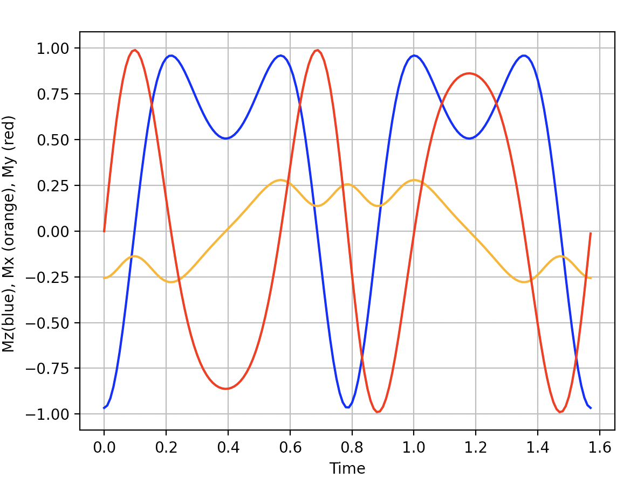
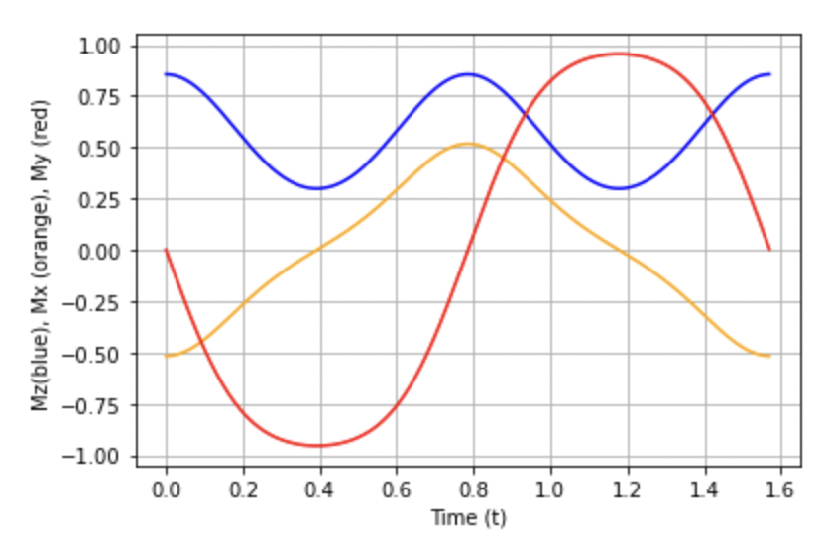




$M_{x}, M_{y}, M_{z} VS Time(t)$ Plot
Observations:
It seems that the old code produces a dynamic that is faster
The old one has higher values than the QuTiP
These things could come from the highly uncertain high frequencies terms of the Fourier expansion of the old algorithm
Old Code
QuTiP
${qJ=2;B}_{x}=8$; $ω=4$
${qJ=2;B}_{x}=1$; $ω=4$

Slide 23







Magnetization vs $B_{x}$ Plots
$${\overline{M}}_{z}, {\overline{M}}_{x}, {\overline{M}}_{y} VS B_{x} Plot$$
$${\overline{M}}_{z} VS B_{x} Plot$$
$$B_{x}=7.3$$
$$B_{x}=13.7$$
$$B_{x}=20$$
$$\sqrt{{\overline{M}}_{x}^{2}+{\overline{M}}_{y}^{2}+{\overline{M}}_{z}^{2}} VS B_{x} Plot$$
$$B_{x}=29.7$$
There is actually no ”plateau” region in our system! There is a point, however, within each dome where the total magnetization is zero! And this we guess is the point that yields the global path.
Notes:
Choose the regime around the dome (points) as the center of projection, for different points use different projection center (which is that point itself in the average Magnetization plot)
Plot the angle as a a function of time to find the winding number
For the same dome, does the number of winding is unique or not
Careful on the time step of the calculation of the integral, if there is a sharp change of the angle then you need to put more time step. You can know this if you find the winding number (n) to be a fraction. For more smaller time steps, this should bring us closer and closer to integer.
So we need to define mathematically, on why the evolution one winding number to another winding number, we have to go across a global path.
Do not choose the point close from zero
Cylinder projection: for the zero points, you can find a unique point, to project the zero point to a greater circle.
$2πn=\int_{0}^{T}{\frac{∂θ(t)}{∂t}dt}$ → This to calculate the winding number!
Also check for the winding number from the projection of the (1,0,0), (0,1,0), (0,0,1). SO CHECK 4 CENTER OF PROJECTIONS FOR EACH DOME (maybe take 5 points on each dome), THIS COULD BE THE FINGER PRINT OF EACH DOME!

Slide 24



${\overline{M}}_{z} VS B_{x}$ with different $ω$s
Observation:
Similar to the previous code, the larger the $ω$, the larger $B_{x}$ is needed to make ${\overline{M}}_{z}$ equal to zero.

Slide 25
The Winding Numbers

Slide 26


Winding Numbers
The winding number is defined mathematically as $n=\frac{1}{2π} \int_{0}^{T}{\frac{∂θ}{∂t}dt}$
We use the stereographic projection to project the path from the sphere to the 2D plane
In each dome regions, we project from 4 points
From the x-axis (1,0,0)
From the y-axis (0,1,0)
From the z-axis (0,0,1)
Using the ${\overline{M}}_{x}, {\overline{M}}_{y}, {\overline{M}}_{z}$ point

Slide 27






Stereographic Projection
Mathematics of the Projection
Projection of $(x,y,z)$ from the north pole $\left(0,0,1\right):$
$$X=\frac{2R}{R−z}x$$
$$Y=\frac{2R}{R−z}y$$
where $X$ and $Y$ is the projected values of the path in the sphere to the $xy−$plane
To use another angle of projection, one can just rotate the axis to use the rotated axis north pole! Or equivalently, rotating the whole path to the new axis!

Slide 28
Magnetization vs $B_{x}$ Plots
$${\overline{M}}_{z}, {\overline{M}}_{x}, {\overline{M}}_{y} VS B_{x} Plot$$
$${\overline{M}}_{z} VS B_{x} Plot$$
$$B_{x}=7.3$$
$$B_{x}=13.7$$
$$B_{x}=20$$
$$\sqrt{{\overline{M}}_{x}^{2}+{\overline{M}}_{y}^{2}+{\overline{M}}_{z}^{2}} VS B_{x} Plot$$
$$B_{x}=29.7$$
There is actually no ”plateau” region in our system! There is a point, however, within each dome where the total magnetization is zero! And this we guess is the point that yields the global path.
Notes:
Choose the regime around the dome (points) as the center of projection, for different points use different projection center (which is that point itself in the average Magnetization plot)
Plot the angle as a a function of time to find the winding number
For the same dome, does the number of winding is unique or not
Careful on the time step of the calculation of the integral, if there is a sharp change of the angle then you need to put more time step. You can know this if you find the winding number (n) to be a fraction. For more smaller time steps, this should bring us closer and closer to integer.
So we need to define mathematically, on why the evolution one winding number to another winding number, we have to go across a global path.
Do not choose the point close from zero
Cylinder projection: for the zero points, you can find a unique point, to project the zero point to a greater circle.
$2πn=\int_{0}^{T}{\frac{∂θ(t)}{∂t}dt}$ → This to calculate the winding number!
Also check for the winding number from the projection of the (1,0,0), (0,1,0), (0,0,1). SO CHECK 4 CENTER OF PROJECTIONS FOR EACH DOME (maybe take 5 points on each dome), THIS COULD BE THE FINGER PRINT OF EACH DOME!

Slide 29









First Dome $$B_{x}≈6$$
Projection from (1,0,0)
Projection from (0,1,0)
Projection from (0,0,1)
Projection from (${\overline{M}}_{x},{\overline{M}}_{y},{\overline{M}}_{z}$)
Total Winding = -5.194e-06
Total winding $=0.992$
Total winding $=0.992$
Total Winding $=0.0014$
Notes:
Try to use $Δθ=\frac{\sqrt{ΔX^{2}+ΔY^{2}}}{\sqrt{{\overline{X}}^{2}+{\overline{Y}}^{2}}}$,

Slide 30









First Dome $$B_{x}≈7.3 (the peak)$$
Projection from (1,0,0)
Projection from (0,1,0)
Projection from (0,0,1)
Projection from (${\overline{M}}_{x},{\overline{M}}_{y},{\overline{M}}_{z}$)
Total Winding $=0.0019$
Total Winding = -6.84e-06
Total winding $=1.010$
Total winding $=1.014$

Slide 31







First Dome $$B_{x}≈8.9$$
Projection from (1,0,0)
Projection from (0,1,0)
Projection from (0,0,1)
Projection from (${\overline{M}}_{x},{\overline{M}}_{y},{\overline{M}}_{z}$)
Total Winding $=0.0024$
Total Winding = 1.848e-06
Total winding $=1.010$
Total winding $=1.010$

Slide 32









Second Dome $$B_{x}≈12$$
Projection from (1,0,0)
Projection from (0,1,0)
Projection from (0,0,1)
Projection from (${\overline{M}}_{x},{\overline{M}}_{y},{\overline{M}}_{z}$)
Total Winding $=0.0029$
Positive Winding = 1
Negative Winding = 1
Total Winding = 1.504e-05
Total winding $=\text{1.02}\text{1}$
Total winding $=\text{1.02}\text{1}$

Slide 33








Second Dome $$B_{x}≈13.7 (peak)$$
Projection from (1,0,0)
Projection from (0,1,0)
Projection from (0,0,1)
Projection from (${\overline{M}}_{x},{\overline{M}}_{y},{\overline{M}}_{z}$)
Total Winding $=0.0035$
Total Winding = 2.871e-06
Total winding $=\text{0.97}\text{1}$
Total winding $=0.971$

Slide 34









Second Dome $$B_{x}≈15$$
Projection from (1,0,0)
Projection from (0,1,0)
Projection from (0,0,1)
Projection from (${\overline{M}}_{x},{\overline{M}}_{y},{\overline{M}}_{z}$)
Total Winding $=0.0039$
Total Winding = 2.871e-06
Total winding $=\text{0.97}\text{9}$
Total winding $=0.979$

Slide 35








Third Dome $$B_{x}≈18$$
Projection from (1,0,0)
Projection from (0,1,0)
Projection from (0,0,1)
Projection from (${\overline{M}}_{x},{\overline{M}}_{y},{\overline{M}}_{z}$)
Total Winding $=0.0045$
Total Winding = -2.107e-05
Total winding $=\text{0.962}$
Total winding $=0.964$

Slide 36








Third Dome $$B_{x}≈20 (peak)$$
Projection from (1,0,0)
Projection from (0,1,0)
Projection from (0,0,1)
Projection from (${\overline{M}}_{x},{\overline{M}}_{y},{\overline{M}}_{z}$)
Total Winding $=0.0051$
Total Winding = -1.697e-05
Total winding $=\text{1.054}$
Total winding $=1.054$

Slide 37
Magnetization vs $B_{x}$ Plots
$${\overline{M}}_{z}, {\overline{M}}_{x}, {\overline{M}}_{y} VS B_{x} Plot$$
$${\overline{M}}_{z} VS B_{x} Plot$$
$$B_{x}=7.3$$
$$B_{x}=13.7$$
$$B_{x}=20$$
$$\sqrt{{\overline{M}}_{x}^{2}+{\overline{M}}_{y}^{2}+{\overline{M}}_{z}^{2}} VS B_{x} Plot$$
$$B_{x}=29.7$$
There is actually no ”plateau” region in our system! There is a point, however, within each dome where the total magnetization is zero! And this we guess is the point that yields the global path.
Notes:
Choose the regime around the dome (points) as the center of projection, for different points use different projection center (which is that point itself in the average Magnetization plot)
Plot the angle as a a function of time to find the winding number
For the same dome, does the number of winding is unique or not
Careful on the time step of the calculation of the integral, if there is a sharp change of the angle then you need to put more time step. You can know this if you find the winding number (n) to be a fraction. For more smaller time steps, this should bring us closer and closer to integer.
So we need to define mathematically, on why the evolution one winding number to another winding number, we have to go across a global path.
Do not choose the point close from zero
Cylinder projection: for the zero points, you can find a unique point, to project the zero point to a greater circle.
$2πn=\int_{0}^{T}{\frac{∂θ(t)}{∂t}dt}$ → This to calculate the winding number!
Also check for the winding number from the projection of the (1,0,0), (0,1,0), (0,0,1). SO CHECK 4 CENTER OF PROJECTIONS FOR EACH DOME (maybe take 5 points on each dome), THIS COULD BE THE FINGER PRINT OF EACH DOME!

Slide 38







Zero Point $$B_{x}≈17.2 (when \overline{M}=0)$$
Projection from (1,0,0)
Projection from (0,1,0)
Projection from (0,0,1)
Projection from (${\overline{M}}_{x},{\overline{M}}_{y},{\overline{M}}_{z}$)
Total Winding $=0.0043$
Total Winding = -0.952
Total winding $=\text{1.939}\text{e}\text{−06}$
Total winding $=1.939e−06$

Slide 39








Finding the Transition Point $$B_{x}≈17.5 (when \overline{M}=0)$$
Projection from (1,0,0)
Projection from (0,1,0)
Projection from (0,0,1)
Projection from (${\overline{M}}_{x},{\overline{M}}_{y},{\overline{M}}_{z}$)
Total Winding $=0.0044$
Total Winding = -0.961
Total winding $=\text{−}\text{1.}\text{665}\text{e}\text{−06}$
Total winding $=0.0044$
Around $B_{x}=17.5$ is the transition point!

Slide 40







Finding the Transition Point $$B_{x}≈17.6$$
Projection from (1,0,0)
Projection from (0,1,0)
Projection from (0,0,1)
Projection from (${\overline{M}}_{x},{\overline{M}}_{y},{\overline{M}}_{z}$)
Total Winding $=0.0044$
Total Winding = -1.731e-05
Total winding $=\text{0.955}$
Total winding $=0.954$

Slide 41






Finding the Transition Point $$B_{x}≈16.9$$
Projection from (1,0,0)
Projection from (0,1,0)
Projection from (0,0,1)
Total Winding $=0.0043$
Total Winding = 0.923
Total winding $=\text{−5.361}\text{e}\text{−06}$

Slide 42


Finding the Transition Point $$B_{x}≈16.8$$
Projection from (1,0,0)
Projection from (0,1,0)
Projection from (0,0,1)
Total Winding $=0.0043$
Total Winding = 0.923
Total winding $=\text{−5.361}\text{e}\text{−06}$

Slide 43






Zero Point $$B_{x}≈23.4 (when \overline{M}=0)$$
Projection from (1,0,0)
Projection from (0,1,0)
Projection from (0,0,1)
Total Winding $=0.0059$
Total Winding = -1.078
Total winding $=\text{9.682}\text{e}\text{−06}$

Slide 44
Future Plans
What will we be doing next

Slide 45




Future Plans
Use the turning number instead of the winding number to characterize each domes
Instead of using a reference point and calculate the winding number, we could maybe use how many times a normal vector of the path has turned $2π$ times.
2. Try to define the global and local path using the Cylindrical/Mercator projection
The Projection: $$x=λ−λ_{0}$$
$$y=ln⁡(\tan\left(φ\right)+\sec{(φ)})$$
where $λ$ is the longitude and $φ$ is the latitude

Slide 46
Thank you for listening!
Feel free to ask any questions or comments!

Slide 47
Some New Results!

Slide 48









Winding Number in ${\overline{M}}_{y}$ Regime
Legend:
$${\overline{M}}_{x}$$
$${\overline{M}}_{y}$$
$${\overline{M}}_{z}$$
Winding number in the $M_{y}$ regime
$B_{x}=8.8$
Winding Number = 1.001
$B_{x}=10.3$
Winding Number = 1.1756
$B_{x}=10.8$
Winding Number = -1.0284
$B_{x}=11.5$
Winding Number = -1.0209
$B_{x}=11.8$
Winding Number = -1.0226
$$B_{x}=8.8$$
$$B_{x}=10.8$$
$$B_{x}=11.8$$

Slide 49





Winding Number in ${\overline{M}}_{y}$ Regime
Legend:
$${\overline{M}}_{x}$$
$${\overline{M}}_{y}$$
$${\overline{M}}_{z}$$
Winding number in the $M_{y}$ regime
$B_{x}=15.2$
Winding Number = -0.9805
$B_{x}=16.2$
Winding Number = -0.9501
$B_{x}=17.1$
Winding Number = 0.9498
$B_{x}=17.6$
Winding Number = 0.9623
$B_{x}=18.1$
Winding Number = 0.9608
$$B_{x}=15.1$$
$$B_{x}=17.1$$
$$B_{x}=18.1$$

Slide 50
Looking from the energies of different initial guesses, we see that a good choice of initial guess is $M_{z}\left(t\right)=1$ when we use category A
Initial Guess $M_{z}\left(t\right)=1$
Initial Guess $M_{z}\left(t\right)=\sin{(ωt)}$
Average Energy
Observation:
We observe that using $M_{z}\left(t\right)=1$ as the initial guess have the lowest average energies values!

Slide 51


Slide 52



